Slide 1

CHAPTER 5
SEQUENCES, MATHEMATICAL INDUCTION, AND RECURSION
Copyright © Cengage Learning. All rights reserved.

Slide 2
SECTION 5.3
Mathematical Induction II
Copyright © Cengage Learning. All rights reserved.

Slide 3
Mathematical Induction II
In natural science courses, deduction and induction are presented as alternative modes of thought—deduction being to infer a conclusion from general principles using the laws of logical reasoning, and induction being to enunciate a general principle after observing it to hold in a large number of specific instances.
In this sense, then, mathematical induction is not inductive but deductive.
Once proved by mathematical induction, a theorem is known just as certainly as if it were proved by any other mathematical method.

Slide 4
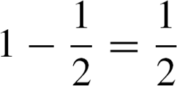
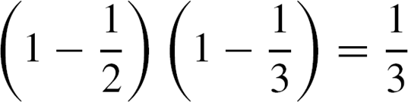
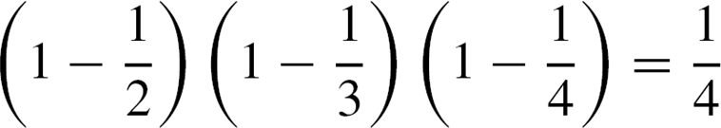
Mathematical Induction II
Inductive reasoning, in the natural sciences sense, is used in mathematics, but only to make conjectures, not to prove them.
For example, observe that

Slide 5
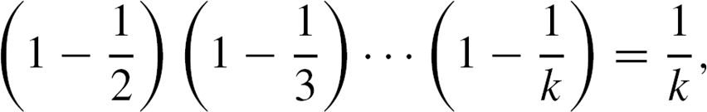
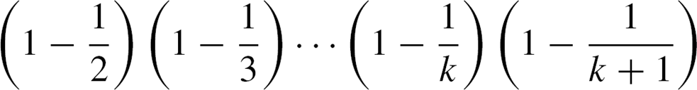
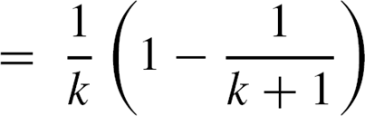
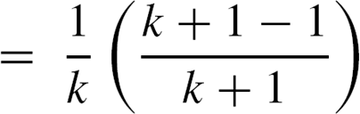
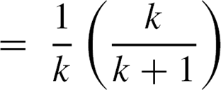
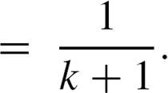
Mathematical Induction II
then by substitution
Thus mathematical induction makes knowledge of the general pattern a matter of mathematical certainty rather than vague conjecture.

Slide 6
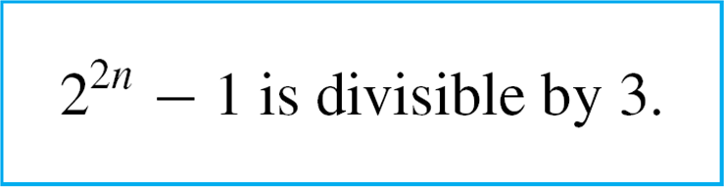

Example 1 – Proving a Divisibility Property
Use mathematical induction to prove that for all integers
n ≥ 0, 2^{2n} – 1 is divisible by 3.
Solution:
As in the previous proofs by mathematical induction, you need to identify the property P(n).
In this example, P(n) is the sentence

Slide 7
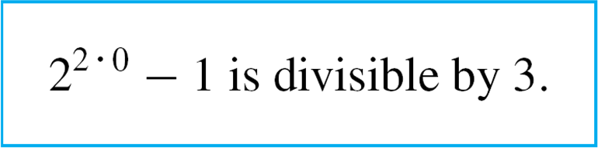

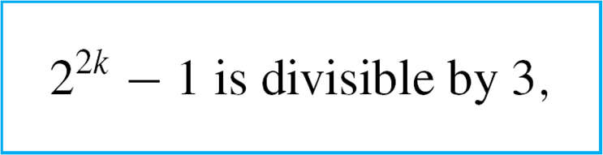
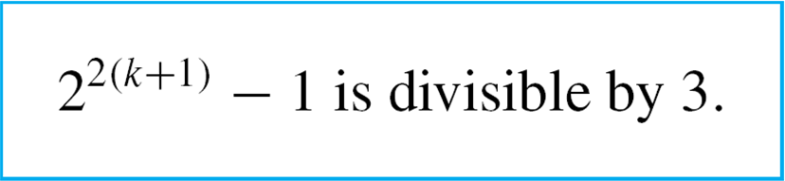
Example 1 – Solution
cont’d
By substitution, the statement for the basis step, P(0), is
The supposition for the inductive step, P(k), is
and the conclusion to be shown, P(k + 1), is

Slide 8
Example 1 – Solution
cont’d
We know that an integer m is divisible by 3 if, and only if,
m = 3r for some integer r.
Now the statement P(0) is true because
2^{2 🞄 0} – 1 = 2⁰ – 1 = 1 – 1 = 0, which is divisible by 3
because 0 = 3 🞄 0.
To prove the inductive step, you suppose that k is any integer greater than or equal to 0 such that P(k) is true.
This means that 2^{2k} – 1 is divisible by 3. You must then prove the truth of P(k + 1). Or, in other words, you must show that 2^{2(k+1)} – 1 is divisible by 3.

Slide 9


Example 1 – Solution
cont’d
But
The aim is to show that this quantity, 2^{2k} 🞄 4 – 1, is divisible by 3. Why should that be so? By the inductive hypothesis, 2^{2k} – 1 is divisible by 3, and 2^{2k} 🞄 4 – 1 resembles 2^{2k} – 1.

Slide 10
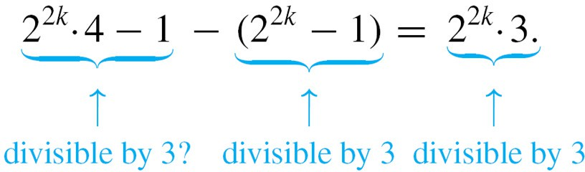
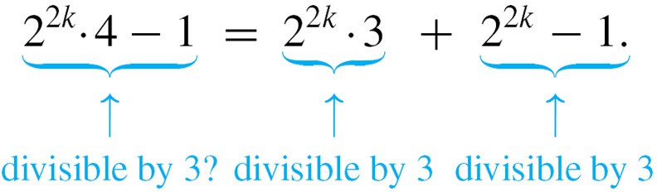
Example 1 – Solution
cont’d
Observe what happens, if you subtract 2^{2k} – 1 from 2^{2k} 🞄 4 – 1:
Adding 2^{2k} – 1 to both sides gives
Both terms of the sum on the right-hand side of this equation are divisible by 3; hence the sum is divisible by 3.

Slide 11
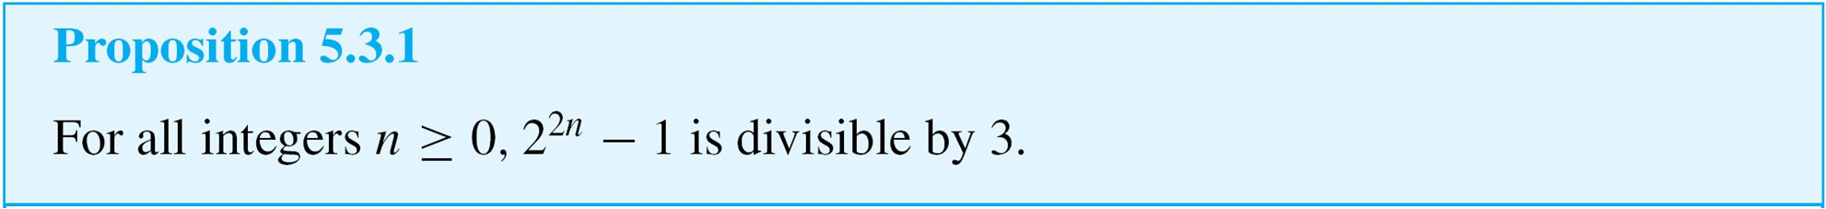
Example 1 – Solution
cont’d
Therefore, the left-hand side of the equation is also divisible by 3, which is what was to be shown.
This discussion is summarized as follows:
Proof (by mathematical induction):
Let the property P(n) be the sentence “2^{2n} – 1 is divisible by 3.”

Slide 12
Example 1 – Solution
cont’d
Show that P(0) is true:
To establish P(0), we must show that
But
and 0 is divisible by 3 because 0 = 3 🞄 0.
Hence P(0) is true.

Slide 13
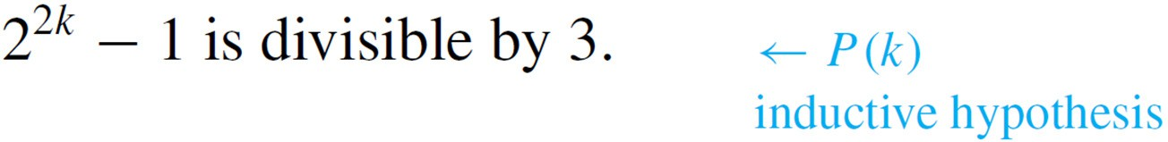
Example 1 – Solution
cont’d
Show that for all integers k ≥ 0, if P(k) is true then
P(k + 1) is also true:
[Suppose that P(k) is true for a particular but arbitrarily chosen integer k ≥ 0. That is:]
Let k be any integer with k ≥ 0, and suppose that
By definition of divisibility, this means that

Slide 14




Example 1 – Solution
cont’d
[We must show that P(k + 1) is true. That is:] We must show that
But

Slide 15







Example 1 – Solution
cont’d
But is an integer because it is a sum of products of integers, and so, by definition of divisibility, is divisible by 3 [as was to be shown].
[Since we have proved the basis step and the inductive step, we conclude that the proposition is true.]

Slide 16
Mathematical Induction II
The next example illustrates the use of mathematical induction to prove an inequality.

Slide 17

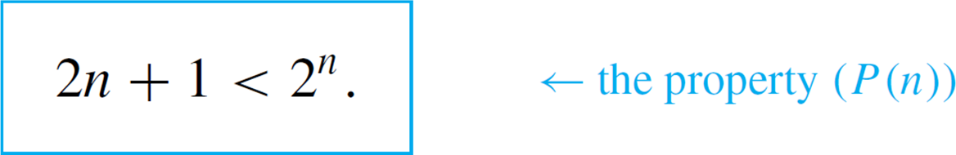
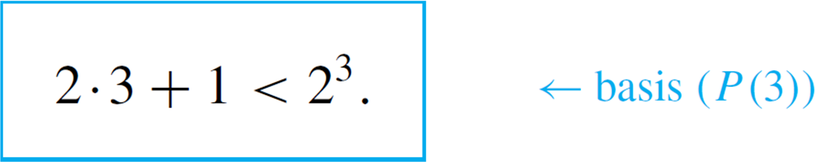
Example 2 – Proving an Inequality
Use mathematical induction to prove that for all integers
n ≥ 3,
Solution:
In this example the property P(n) is the inequality
By substitution, the statement for the basis step, P(3), is

Slide 18
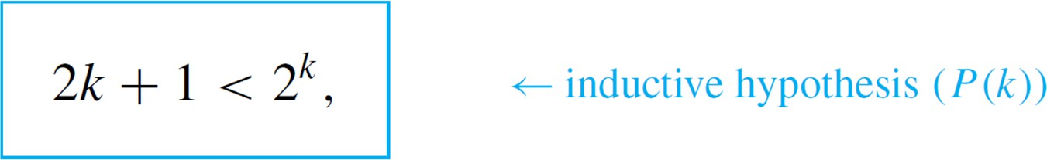
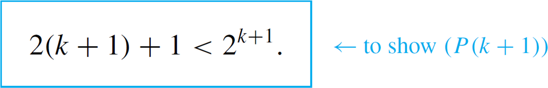
Example 2 – Solution
cont’d
The supposition for the inductive step, P(k), is
and the conclusion to be shown is
To prove the basis step, observe that the statement P(3) is true because 2 🞄 3 + 1 = 7, 2³ = 8, and 7 < 8.

Slide 19

Example 2 – Solution
cont’d
To prove the inductive step, suppose the inductive hypothesis, that P(k) is true for an integer k ≥ 3.
This means that 2k + 1 < 2^{k} is assumed to be true for a particular but arbitrarily chosen integer k ≥ 3.
Then derive the truth of P(k + 1). Or, in other words, show that the inequality is true. But by multiplying out and regrouping,
and by substitution from the inductive hypothesis,

Slide 20

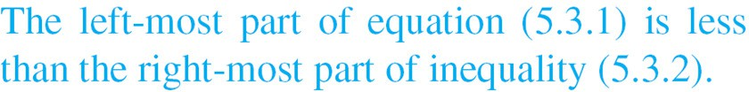
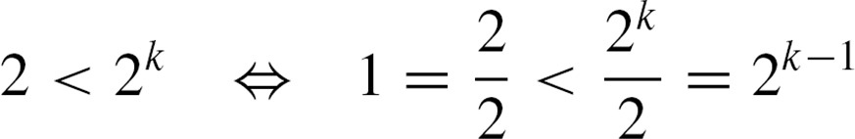
Example 2 – Solution
cont’d
Hence
If it can be shown that 2^{k} + 2 is less than 2^{k+1}, then the desired inequality will have been proved.
But since the quantity 2^{k} can be added to or subtracted from an inequality without changing its direction,
And since multiplying or dividing an inequality by 2 does not change its direction,

Slide 21




Example 2 – Solution
cont’d
This last inequality is clearly true for all k ≥ 2. Hence it is true that .
This discussion is made more flowing (but less intuitive) in the following formal proof:
Proof (by mathematical induction):
Let the property P(n) be the inequality

Slide 22


Example 2 – Solution
cont’d
Show that P(3) is true:
To establish P(3), we must show that
But
Hence P(3) is true.

Slide 23



Example 2 – Solution
cont’d
Show that for all integers k ≥ 3, if P(k) is true then
P(k + 1) is also true:
[Suppose that P(k) is true for a particular but arbitrarily chosen integer k ≥ 3. That is:]
Suppose that k is any integer with k ≥ 3 such that
[We must show that P(k + 1) is true. That is:] We must show that

Slide 24




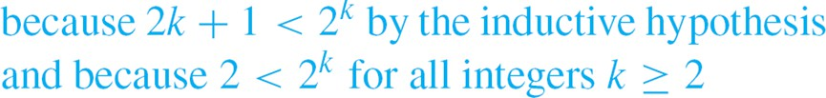
Example 2 – Solution
cont’d
Or, equivalently,
But
[This is what we needed to show.]
[Since we have proved the basis step and the inductive step, we conclude that the proposition is true.]

